Slide 1


FRIENDS day: Big data
Typical day of a big data engineer
https://github.com/sergysta/bd-workshop-may.git
May 2019
by Sergei Stafeev

Slide 2

AGENDA
1
Big Data Overview
2
Case Study: Problem Overview
3
Case Study: Narrowing Down

Slide 3
BIG DATA Overview

Slide 4
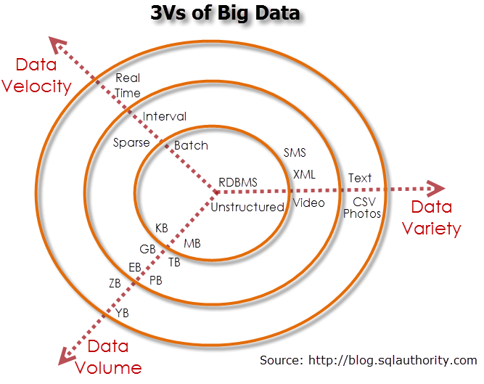
{Prerequisites #1

Slide 5
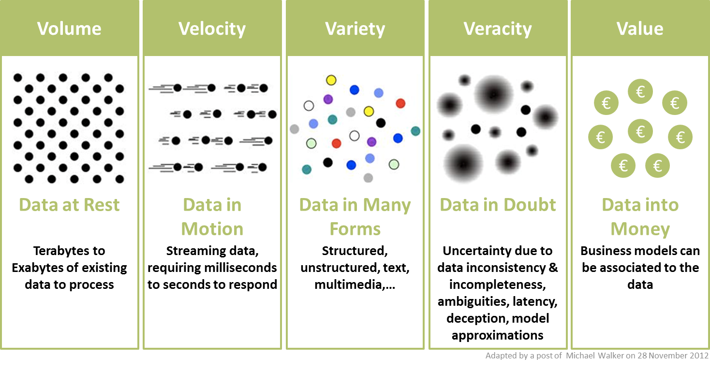
{Prerequisites #2

Slide 6
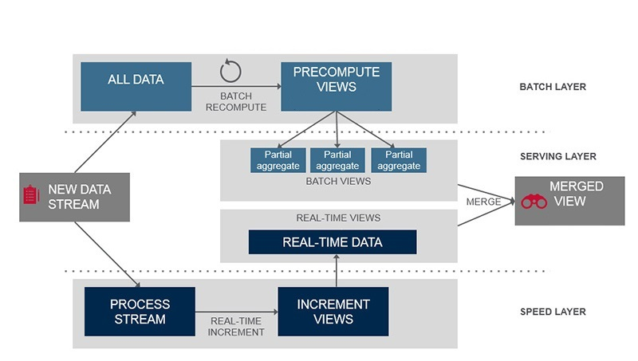
{Big Data approach: Lambda Architecture

Slide 7
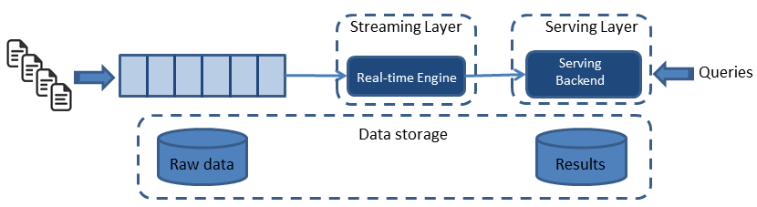
{Big Data approach: KAPPA Architecture

Slide 8
Case study: PROBLEM OVERVIEW

Slide 9
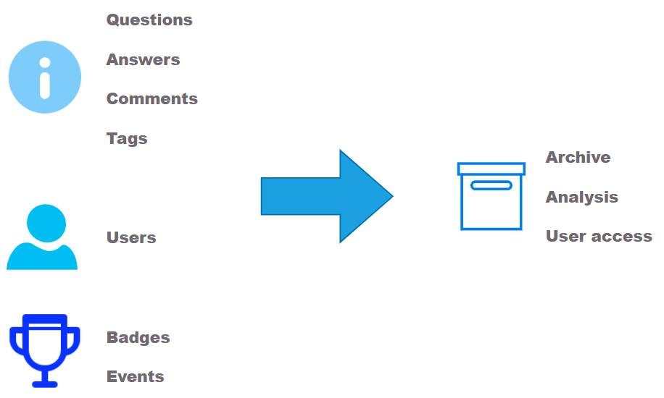
STACKOVERFLOW DATA ETL-PIPELINE

Slide 10

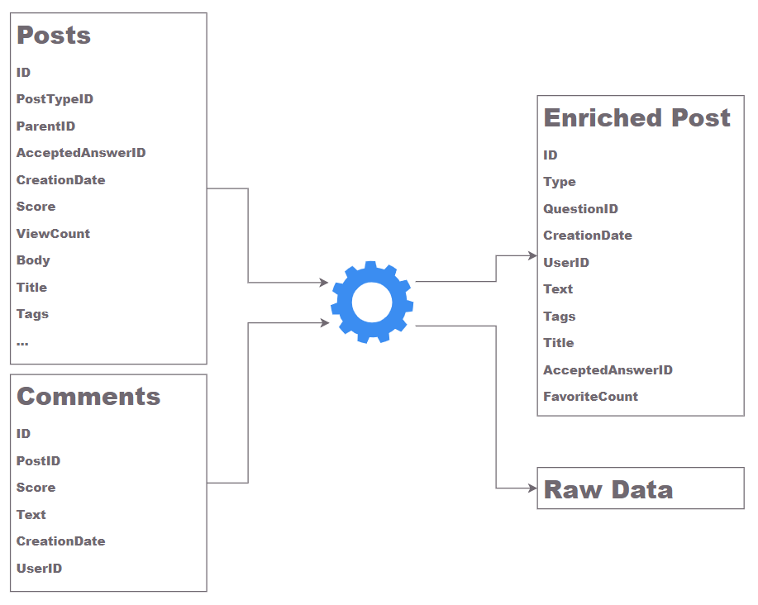

DATA SOURCES
Public dump
Stack Exchange API

Slide 11
Case study: Narrowing down https://github.com/sergysta/bd-workshop-may.git

Slide 12
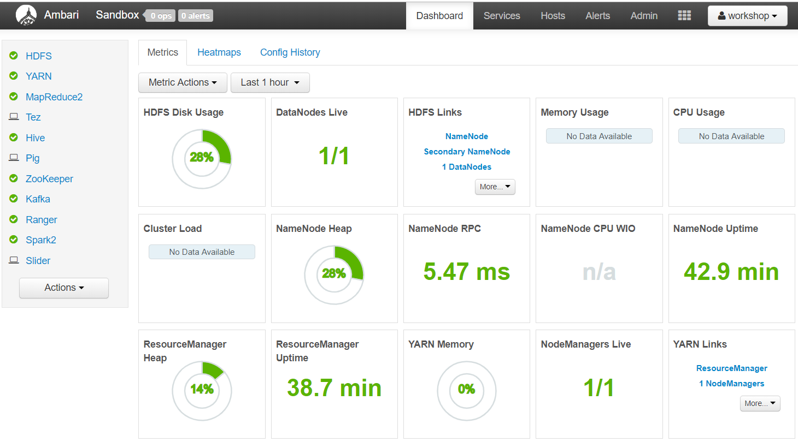
Hortonworks data platform

Slide 13
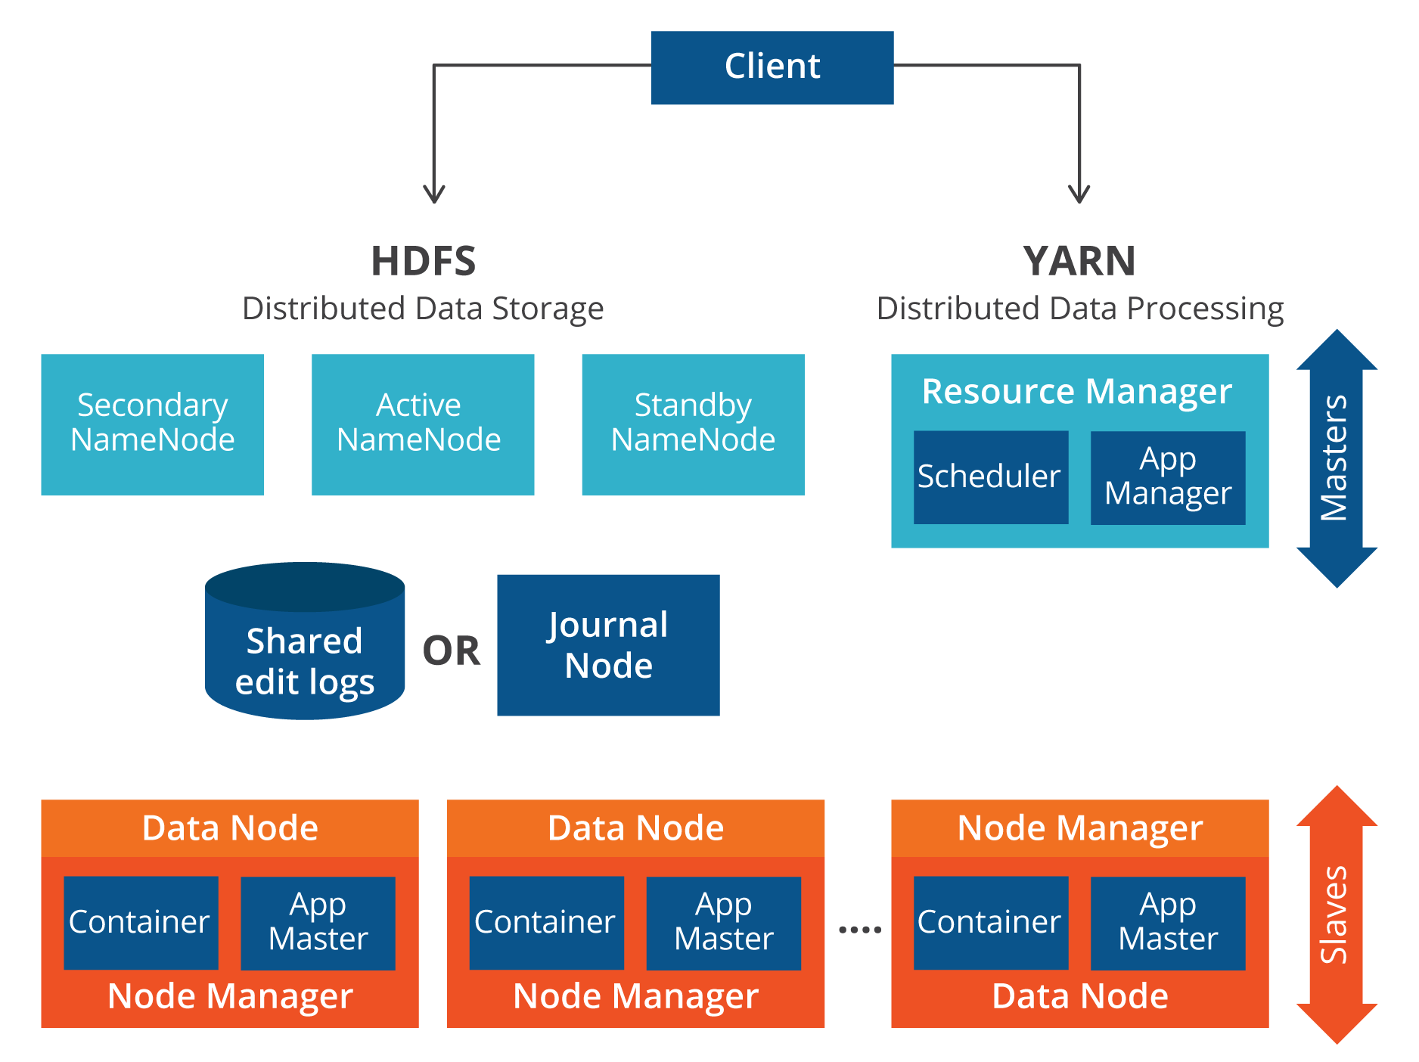
hadoop

Slide 14

hdfs

Slide 15
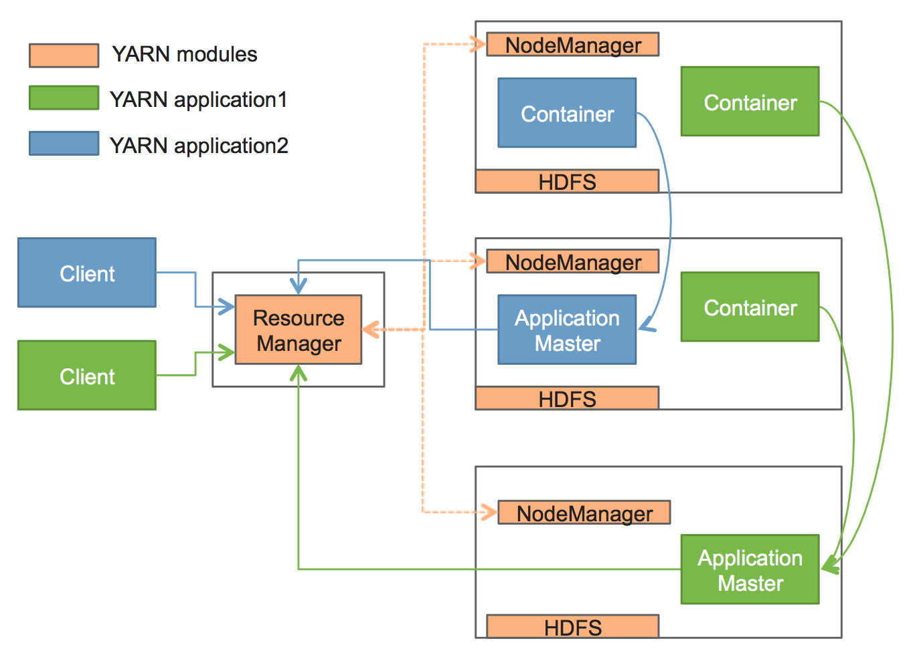
YARN

Slide 16
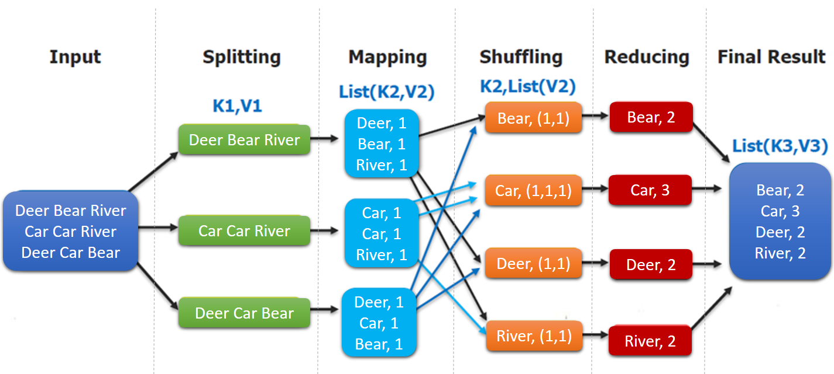
mapreduce

Slide 17
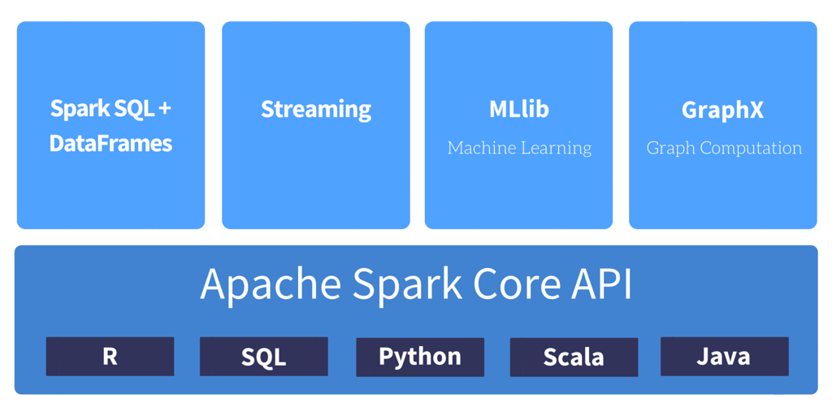
SPARK

Slide 18
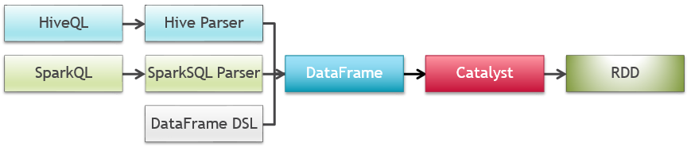
SPARK SQL

Slide 19

PROCESS STACKOVERFLOW DUMP

Slide 20
Hive

Slide 21

DATA ANALYSIS

Slide 22
ELK: Elasticsearch, logstash, kibana

Slide 23
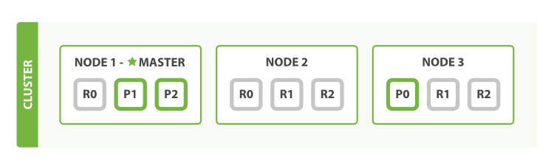
ELASTICSEARCH

Slide 24
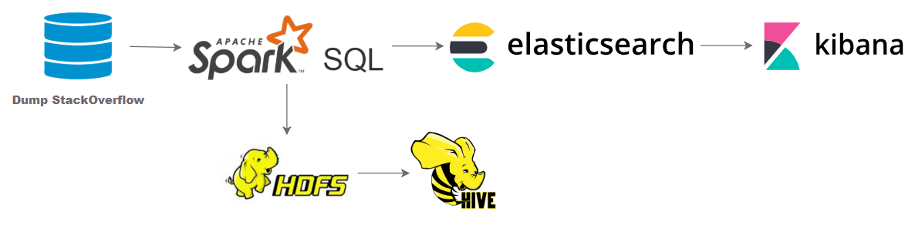
provide data for user interface

Slide 25
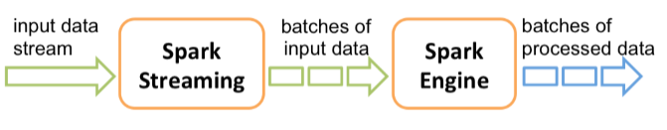
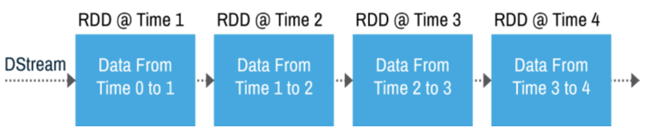
Spark streaming

Slide 26

Add streaming data processing

Slide 27
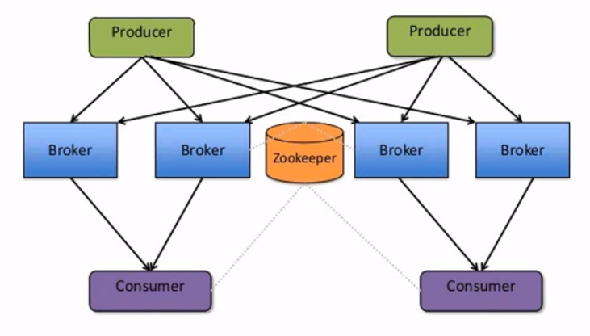
kafka

Slide 28
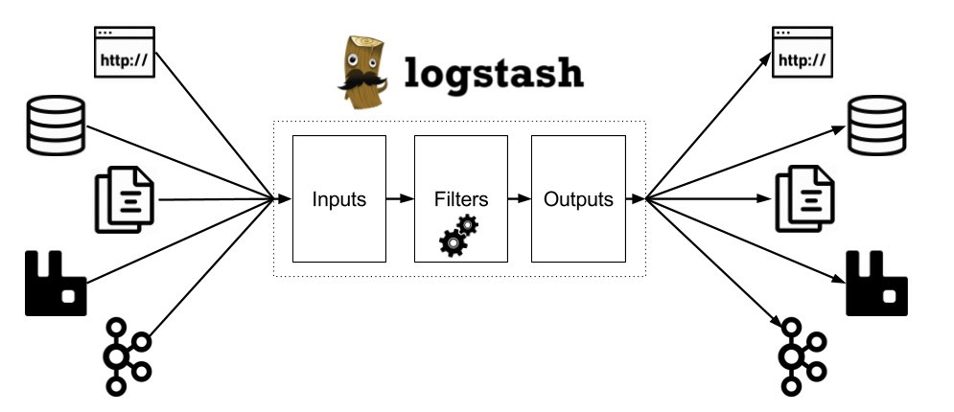
logstash

Slide 29

Provide streaming data for user interface

Slide 30
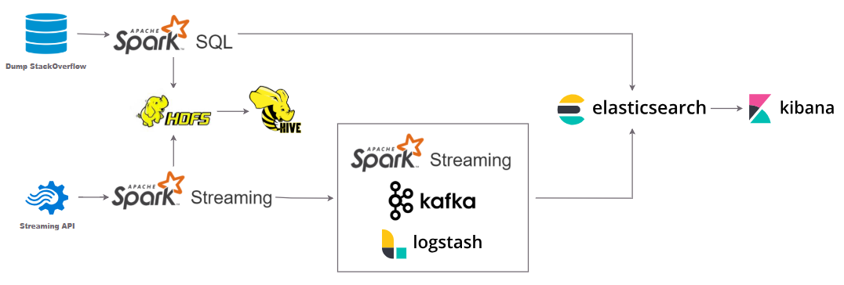
Solution overview

Slide 31
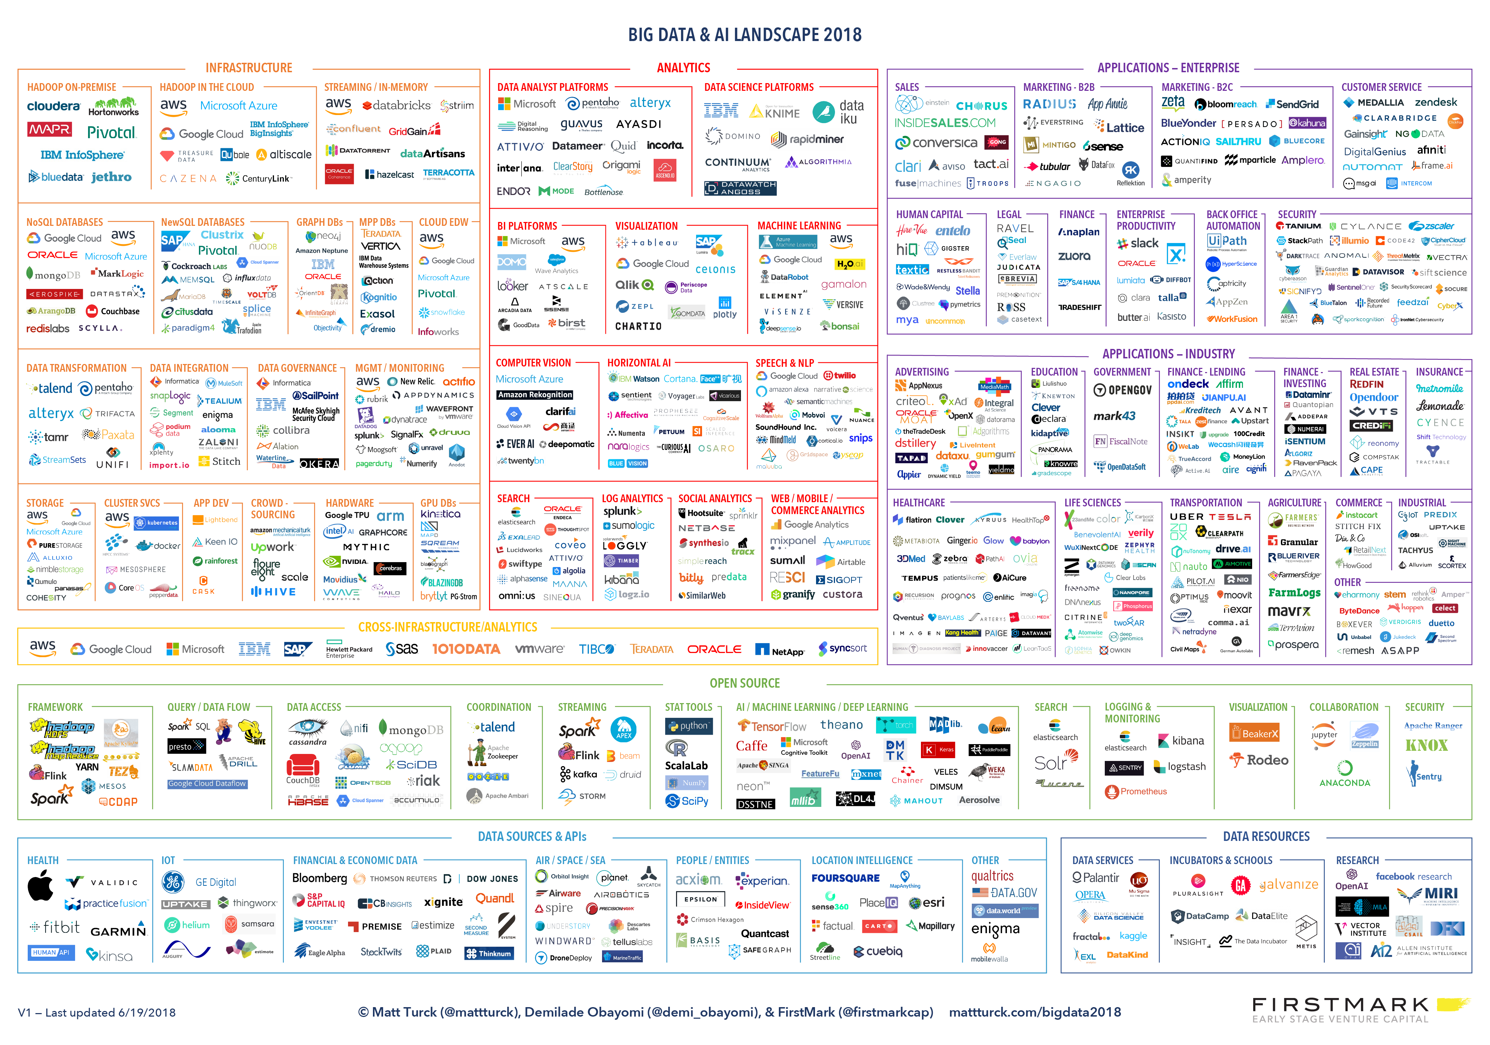
Never stop learning

Slide 32

Thank You!

